Slide 1
“Proposed Enhancements to The Stock Exchange of Hong Kong Limited’s Decision-Making and Governance Structure for Listing Regulation”
31 October 2016 (Monday)
APSA and AIIFL 3rd Roundtable Luncheon Discussion
Hong Kong Research Grants Council Theme-based Research Scheme Project:
“Enhancing Hong Kong’s Future as a Leading International Financial Centre”
Professor S H Goo, HKU
Deputy Head, Department of Law
Founding Director (1999) and former Director (2011-2015), Asian Institute of International Financial Law

Slide 2
Current system in HK
Listing applications considered by SEHK’s Listing Committee
SFC has veto over new listings
SEHK responsible for LR amendment
LR amendment subject to SFC’s approval
Dual filing system

Slide 3
Comparisons with US
Like SEC in US, SFC does not set listing standards, but listing rules subject to its final approval
Dual filing of statements at SEC and SFC
US exchanges and SEHK self-regulatory
Both US Exchanges and HKEX are listed companies: CONFLICT OF INTEREST. (NYSE is regulated by a separate independent body consisting of independent directors of NYSE Group Inc and other unaffiliated directors, funded by NYSE Regulation)

Slide 4
Comparison with Australia
ASX and HKEX are listed on their own boards respectively
ASIC supervises ASX’s listing and compliance with its own listing rules; SFC supervises HKEX’s compliance
ASX and SEHK are front line regulators of markets and control admission to listing
MAJOR difference: ASX listing rules are not merely contractual but enforceable by ASIC and aggrieved individuals, SEHK listing rules only contractual

Slide 5
UK system
Listing standards are set by UKLA/FCA
Listing applications made to UKLA
FCA has investigatory and enforcement powers for breach of FCA’s rules and FSMA 2000
LSE can set additional standards and enforce those standards

Slide 6
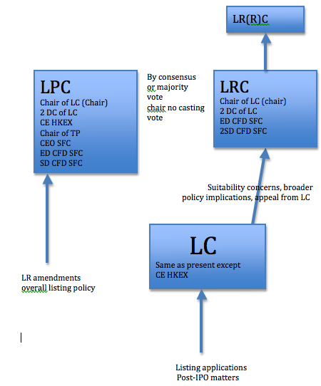
Proposed changes

